Slide 1
It is important to know both grievance and complaint processes.
YFA is not endorsing any specific issues or campus climate issues when addressing this topic. The following is important YFA and YCCD policy information that all Faculty, Staff and Students need to know.

Slide 2
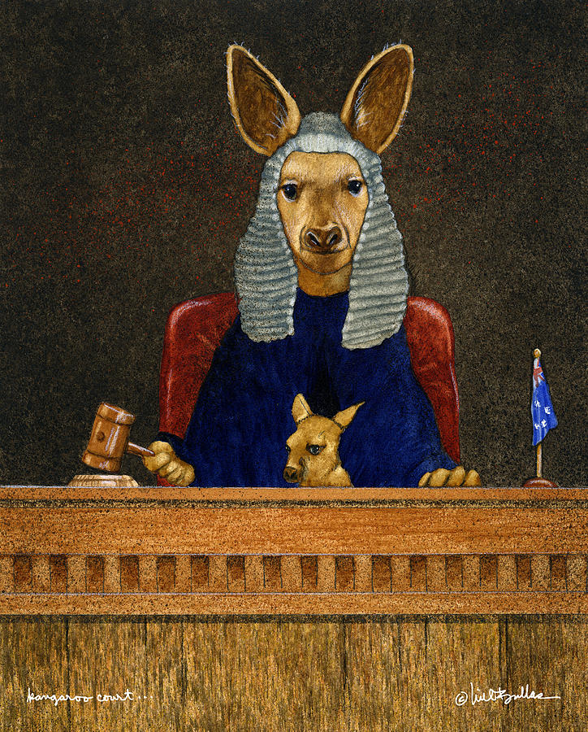
YFA Grievance Process
Article 25 of the Collective Bargaining Agreement

Slide 3
The Grievance Process—the friendly, collegial, structured nuclear option of the Collective Bargaining Agreement.

Slide 4
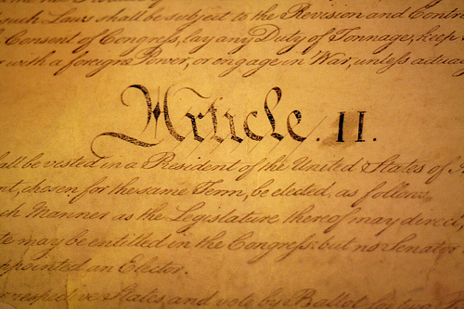
Goal of the Grievance Process
The goal of a grievance is to address a violation, misapplication or misinterpretation of the CBA.
To be effective in a grievance, you need to be able to specify the section of the CBA that has been violated.

Slide 5
Sometimes a grievance is not a grievance…
As faculty members and human beings, we sometimes experience conflict in our workplace that is highly frustrating!
Disagreement with admin or co-workers
Dissatisfaction over processes, department issues
Personal issues with others
YFA can be a resource for you outside the grievance process as well!

Slide 6
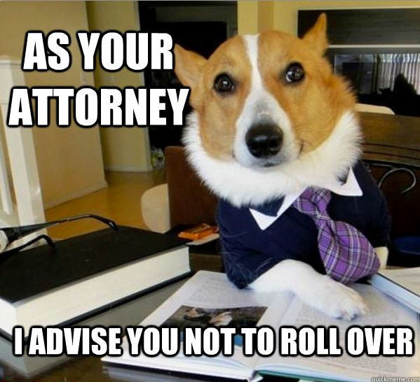
YFA will provide support and representation at all levels of the grievance process.
The grievance process is NOT the time to discuss your issues with all your colleagues, get them to write letters, storm the Board meetings, and close down Sawmill Road. From the point of entering grievance, the process, issues or evidence must not be shared publicly.

Slide 7
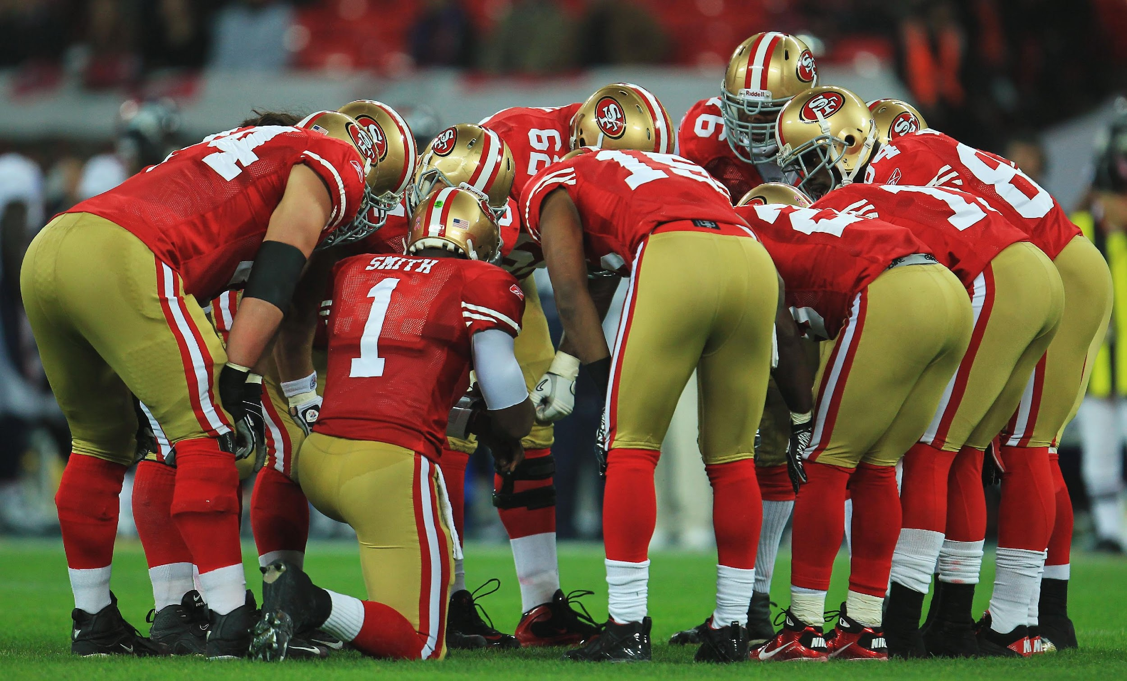
Group Grievance
Group Grievances are possible if the YFA and District feel that there are significant similar characteristics for a number of individuals, and that it would be beneficial to hear the grievance as a group.

Slide 8
If you bring forward a grievance, there must not be any reprisal for doing so, regardless of outcome.
This does not mean that you will never have issues with the aggrieved party again, but that care must be taken by all parties to lay to rest the issues that led to grievance.

Slide 9
Grievance Process (25.2), Informal Stage
Meet informally with your administrator. YFA representation encouraged.
If no resolution, the matter is forwarded to the Employer-Employee Relations Committee (EER).
If EER solution is not satisfactory, the matter goes to formal grievance.

Slide 10
Grievance Process, Formal Stage, 3 Levels
25.2.2.1– Level I, Written grievance presented to immediate administrator within 20 days of resolution of informal process. Admin must respond in 10 days, or it will escalate to Level II.
25.2.2.5—Level II, Grievant may appeal decision to the College President (or designee) within 10 days. (TIME SENSITIVE!) Admin must respond within 10 days.
25.2.2.9—Level III, appeal to Chancellor. Same timelines apply.

Slide 11
Arbitration—let’s not go there…
Article 23.5 of the CBA explains the Arbitration Process.

Slide 12
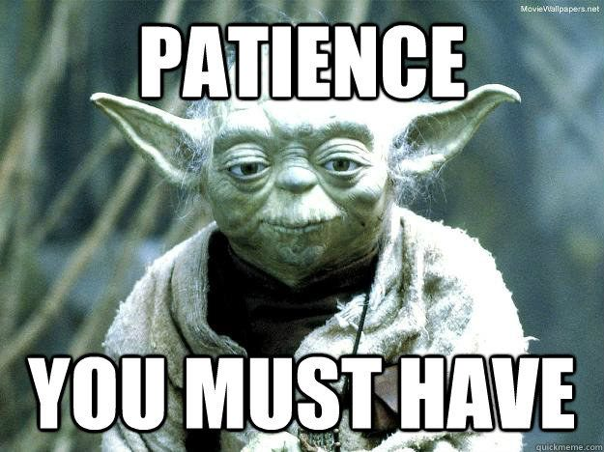
Important Points to Remember…
Document your process that led to the grievance.
Document each part of your grievance process.
Utilize the help and support of your YFA officers.
There is a process that must be adhered to. Know your CBA.
Mistakes will be made. When the District makes them, it can help you.
This can be a highly emotional process. Patience is required…

Slide 13
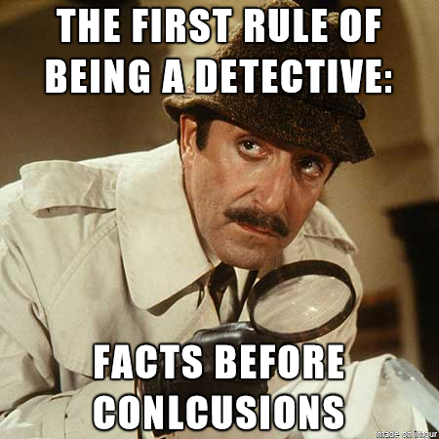
Complaint Process, Administrative Process #3435
Covers issues of harassment, discrimination or retaliation
Has informal and formal processes
Received and investigated through HR (Kathren Prichard)

Slide 14
Informal Complaint Process
Written allegation of harassment, discrimination or retaliation
“Informal” because it’s out of timelines (1 yr) or prefers informal
Informal complaint can go to HR or any college admin
HR will respond, advise of your rights
HR will determine to formally or informally investigate and/or resolve
In a serious matter, HR may investigate w/o complainant's consent

Slide 15
Formal Complaint Process
Written or Verbal statement filed with the District that alleges harassment, discrimination or retaliation in violation of District policies, procedures or state/federal law.
File with HR Director (or Chancellor, if the complaint is about HR.)

Slide 16
Formal Complaint Process cont.
A formal complaint must meet the following criteria:
It must allege facts with enough specificity that it would constitute a violation of Dist policies or procedures prohibiting discrimination, harassment or retaliation.
Must be filed within one year of the date of the conduct (or one year from the complainant learning about the conduct.)
If the complaint involves “employment” it must be filed within 180 days.

Slide 17
Formal Complaint Process cont.
If a complaint does not meet the 3 requirements of a Formal Complaint, HR will contact the individual to explain options.
The Senior Director of Human Resources (Kathren Prichard) is responsible for investigating official complaints, and may assign other District personnel to investigate.
Formal complaints can be filed using the District Unlawful Discrimination Complaint Form.
Employees may also file complaints to the U.S. EEOC, or Dept of Fair Employment and Housing.

Slide 18
Formal Complaint Rights/Responsibilities
File a timely complaint, within 30 days if possible
If any employee receives a complaint, forward to HR Pritchard asap
All supervisors and managers are mandatory reporters of harassment and discrimination.
Off-campus actions can involve formal complaints if there is a “demonstrated nexus to an academic or work activity”
There’s more. See the details in AP-3435

Slide 19
Outcomes of Complaint/Investigation:
The District will provide the complainant with a written report of circumstances, procedural steps taken, a summary of testimony, an analysis of data, and a finding of whether it is “highly or substantially more probable to be true than not” that discrimination or harassment occurred.
The District will keep the investigation confidential to the extent possible.
The complainant has a right to appeal the outcome to the Board.

